Slide 1
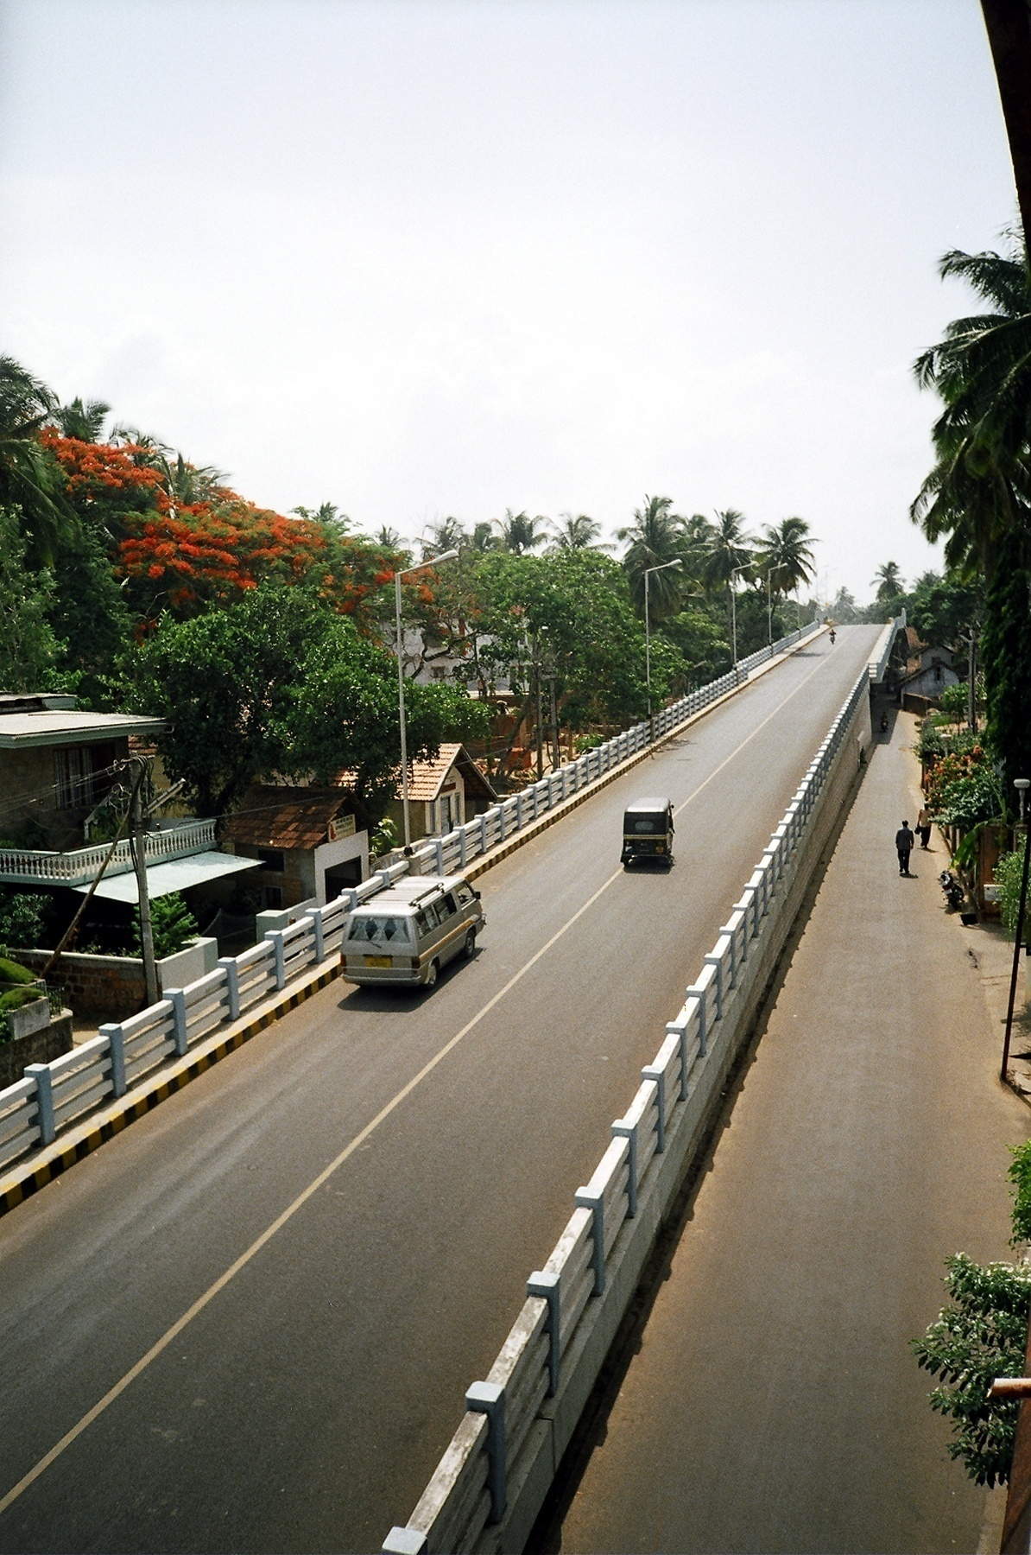
Roads And Bridges Development
Corporation of Kerala LTD
Road to Prosperity
Project Review Meeting –
2nd May 2015

Slide 2
Progress review of ongoing projects
Up gradation of Airport Seaport to four lane - M/s EKK &Co
Flyover at Palarivattom NH66
(Old NH 47) Bypass - RDS Projects ltd
3. ROB at Aloor Mala - M/s CVCC
4. ROB at Angadipuram -M/s CVCC
5. Airport Seaport Road-PhaseII-
Two River Bridges - M/s CVCC
6. ROB at Kumaranelloor - Shri. K.N.Madhusudhanan
7. ROB at Kunjippalli - M/s Skilled
8. ROB at Eroor - M/s Skilled

Slide 3
UP GRADATION OF AIRPORT SEAPORT ROAD TO FOUR LANE -PHASE I

Slide 4
UP GRADATION OF AIRPORT SEAPORT ROAD TO FOUR LANE -PHASE I – PROGRESS REPORT AS ON 30.04.2015
Upgrdadation of airport seaport road to four lane phase -1 from 8+900 to 11+350
Monthly Report
Work progress for the Month of April - 15
Sl. No. | BOQ no | Item Description | Unit | Total | Up to date | Work Planned for April-15 | Quantity of work done for April-15 | Percentage | Work Planning for February -15
 |  |  |  | Quantity | Quantity
1 | 1.01 | Clearing and grubbing road land | HA | 3.9 | 2.891 | 0.00 | 0.00 | 0% | 0.00
2 | 1.09 | Excavation for roadway | Cum | 1320 | 1011 | 10.00 | 0.00 | 0% | 10.00
3 | 1.10 | Earthwork excavation at embankment foundation | Cum | 30210 | 20133 | 250.00 | 337.00 | 135% | 25.00
4 | 1.11 | Loosening, leveling and Compacting | Cum | 1240 | 2774 | 0.00 | 3.60 | 36% | 10.00
5 | 1.12 | Construction of sub-grade and earthen shoulders | Cum | 5290 | 0 | 0.00 | 0.00 | 0% | 0.00
6 | 1.13 | GSB (Grade I) | Cum | 8050 | 5413 | 0.00 | 7.20 | 72% | 50.00
7 | 1.14 | Wet Mix Macadam (WMM) | Cum | 6900 | 4202 | 0.00 | 203.50 | 200% | 50.00
8 | 1.15 | Primer coat (0.75KG/Sqm) | Sqm | 24370 | 15825 | 1000.00 | 0.00 | 292% | 1000.00
9 | 1.16 | Tack coat | Sqm | 50230 | 51851 | 22000.00 | 2923.00 | 0% | 22000.00
10 | 1.17 | BM | Cum | 500 | 927 | 500.00 | 4.75 | 0% | 400.00
11 | 1.18 | DBM | Cum | 5790 | 2670 | 1400.00 | 0.00 | 0% | 1400.00
12 | 1.19 | BC | Cum | 1260 | 0 | 700.00 | 0.00 | 0% | 700.00
13 | 1.20 | Kerb stone | Rm | 8800 | 3581 | 900.00 | 170.00 | 19% | 600.00
14 | 1.27 | Construction of embankment (road way cutting material) | Cum | 3890 | 3467 | 0.00 | 175.00 | 375% | 50.00
15 | 1.28 | PCC M15 for sub-structure - for culverts , drain, utility duct etc | Cum | 1050 | 657 | 25.00 | 53.00 | 212% | 10.00
16 | 1.29 | PCC M25 for sub-structure/super structure etc for culverts , drain, utility duct | Cum | 5070 | 2220 | 10.00 | 5.00 | 50% | 10.00
17 | 1.30 | HYSD bar reinforecemnt in sub -structure | MT | 510 | 183 | 5.00 | 0.04 | 1% | 0.50
18 | 1.36 | M20 grade concrete guard posts 200 x 200 mm x1.25 m | Nos | 550 | 169 | 0.00 | 0.00 | 0% | 0.00
19 | 1.43 | Tree planting | Nos | 350 | 180 | 30.00 | 28.00 | 93% | 20.00

Slide 5
UP GRADATION OF AIRPORT SEAPORT ROAD TO FOUR LANE -PHASE I – PROGRESS REPORT AS ON 30.04.2015
Note
BM , BC works completed
Road marking in progress

Slide 6
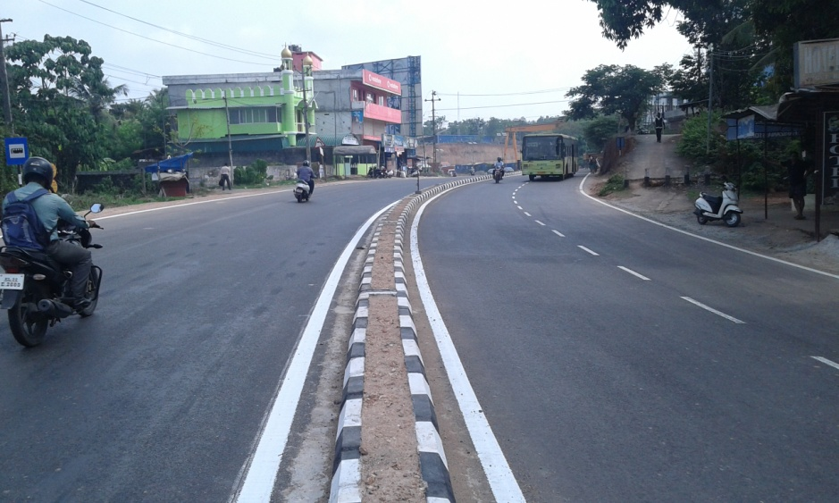
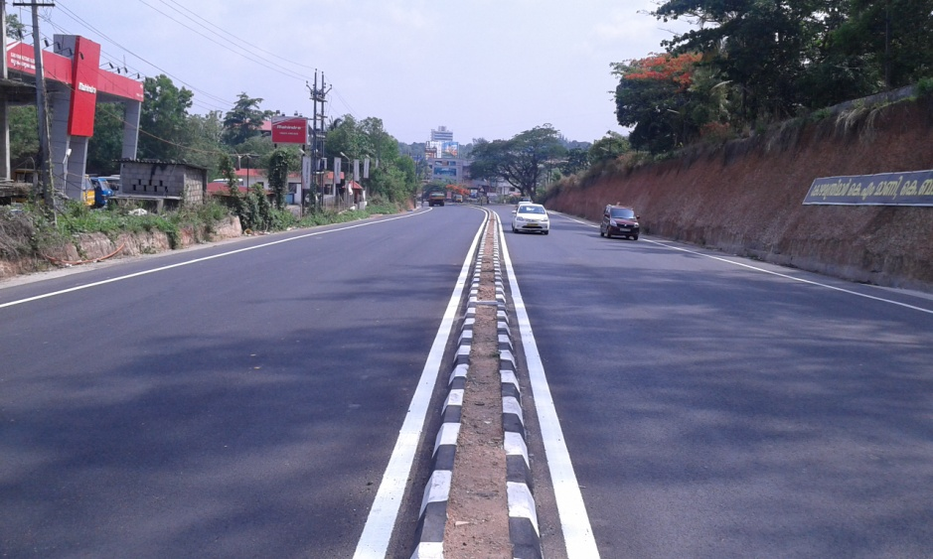
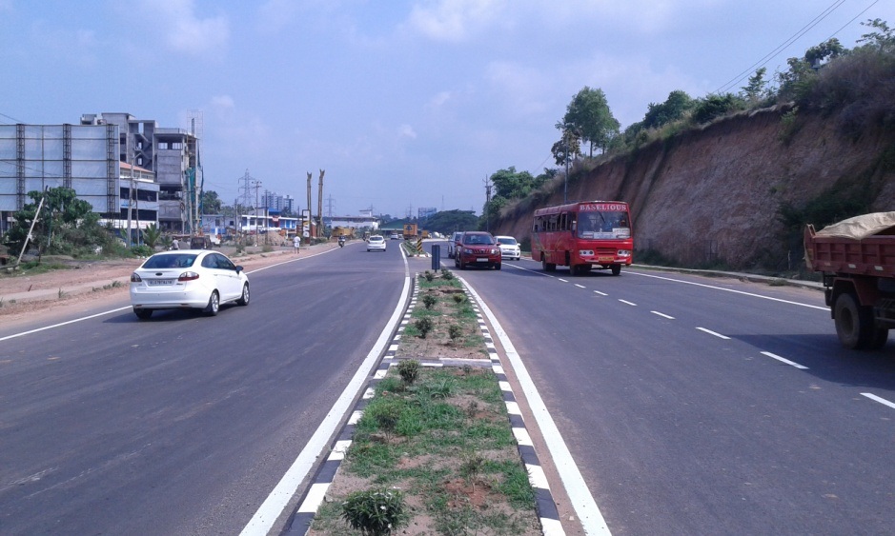
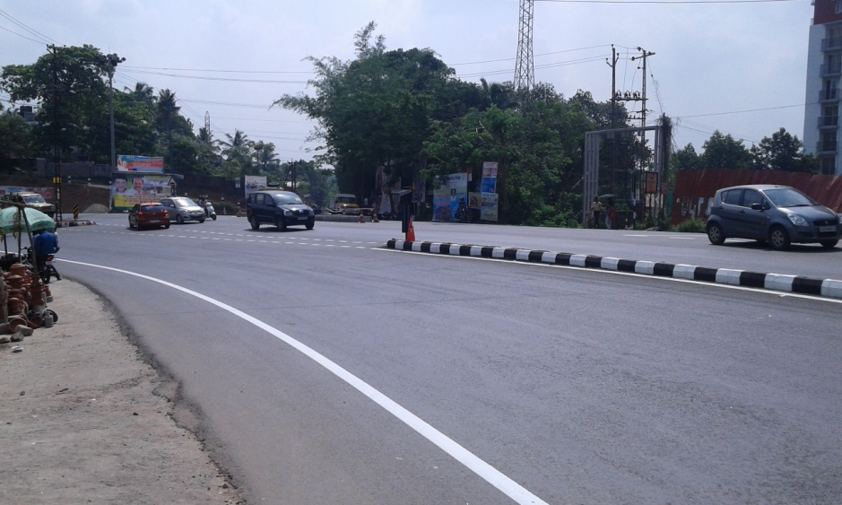
UP GRADATION OF AIRPORT SEAPORT ROAD TO FOUR LANE - PHASE I PROGRESS PHOTOS – 30.04.2015
Road work completed

Slide 7
Flyover at Palarivattom in NH 66 (OLD 47) BYPASS

Slide 8
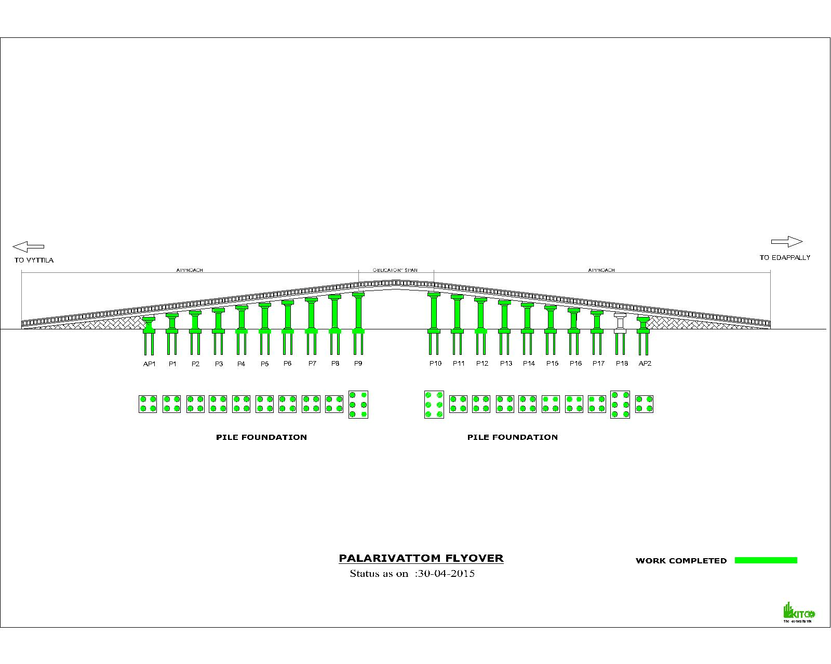
Flyover at Palarivattom in NH 66 (OLD 47) BYPASS
Progress Graph-30.04.2015

Slide 9
Flyover at Palarivattom in NH 66 (OLD 47) BYPASS
Progress Report-30.04.2015
Si No | Activity Description | Total Quantity | Cumulative progress upto 30.04.2015 | Balance work up to 30.04.2015 | Actual work done during the Month | Work planned for next Month | Remarks
1 | PILE Edappally side | 44 | 44 | 0 | 0 | 0 | P10-1,2,3,4,5,6/P11-1,2,3,4/P12-1,2,3,4/P13-1,2,3,4/P14-1,2,3,4/P15-1,2,3,4/P16-1,2,3,4/P17-1,2,3,4/P18-1,2,3,4,5,6/AP2-1,2,3,4
2 | PILE vytilla side | 42 | 42 | 0 | 0 | 0 | AP1-1,3,4,2/ P1-1,2,3,4 / P2-4,2,3,1 / P3-1,2,3,4 / P4-1,2,3,4 /P5-1,2,4,3/P6-1,2,3,4/ P7-1,2,3,4/P8-1,2,3,4/ P9-1,2,3,4,5,6
5 | PILE CAP Edappally side | 10 | 9 | 1 | 0 | 1 | P10,P11,P12,P13,P14,P15,P16,P17,AP2
7 | PILE CAP vytilla side | 10 | 10 | 0 | 0 | 0 | AP1,P1,P2,P3,P4,P5,P6,P7,P8,P9
9 | PIER Edappally side | 10 | 9 | 1 | 0 | 1 | P10,P11,P12,P13,P14,P15,P16,P17,AP2
11 | PIER Vytilla side | 10 | 10 | 0 | 0 | 0 | AP1, P1, P2, P3, P4, P5, P6,P7,P8,P9
13 | PIER CAP Edappally side | 10 | 9 | 1 | 0 | 1 | P10,P11,P12,P13,P14,P15,P16,P17,AP2
14 | PIER CAP Vytilla side | 10 | 10 | 0 | 1 | 0 | AP1,P1,P2,P3,P4,P5,P6,P7,P8,P9
15 | GIRDER EDAPPALLY side | 58 | 16 | 42 | 3 | 8 | G1,G2,G3,G4,G5,G6,G15,G17,G18,G19,G21,G23,G24,G26,G28,G29
16 | GIRDER vytila side | 54 | 13 | 41 | 2 | 7 | G7,G8,G9,G10,G11,G12, G13,G14,G16,G20,G22,G25,G27
16 | GIRDER obligatory span | 10 | 0 | 10 | 0 | 0

Slide 10
Flyover at Palarivattom in NH 66 (OLD 47) BYPASS
Progress Report-30.04.2015
Progress Report of Palarivattom Fly over on 31.04.15
Si No | Activity Description | Total Quantity | Cumulative progress upto 30.04.15 | Balance work up to 30.04.15 | Actual work done during the Month | Work planned for next Month | Remarks
12 | Service road edply west | 100% | 90% | 10% | 0% | 0% | Upto DBM completed
13 | Service road edply east | 100% | 80% | 20% | 80% | Up to DBM | UP TO DBM
14 | Service road vytila west | 100% | 80% | 20% | 70% | Up toDBM | UP TO DBM FIRST LAYER FULL WIDTH
15 | Service road vytila east | 100% | 85% | 15% | 80% | Up to DBM | UP TO DBM SECOND LAYER
 | Note: Drain @ Edappally East in 200 metres will be done

Slide 11
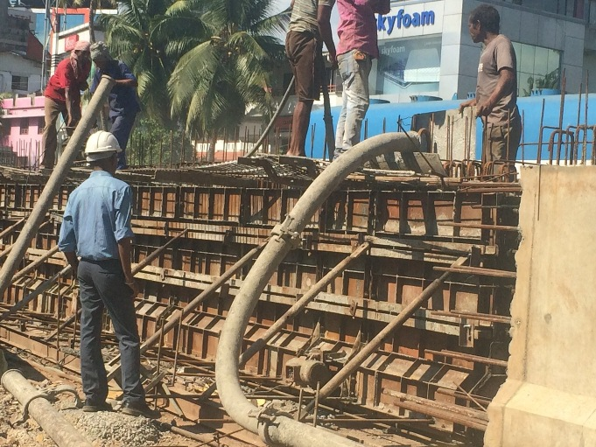
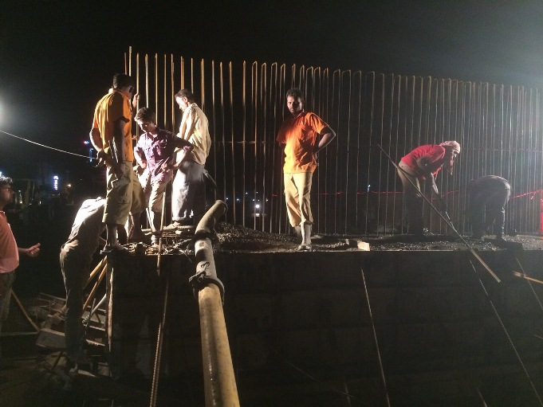
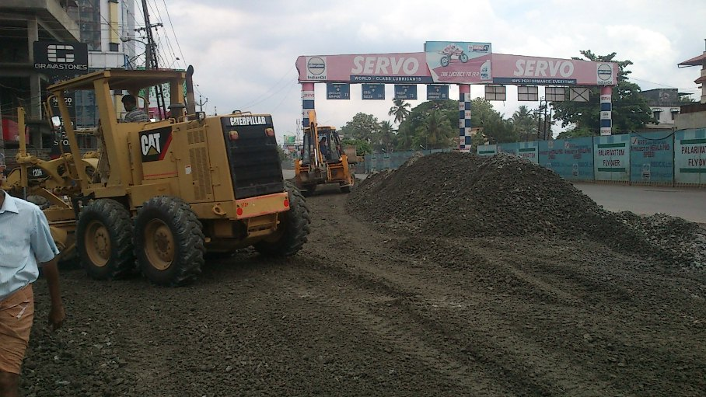
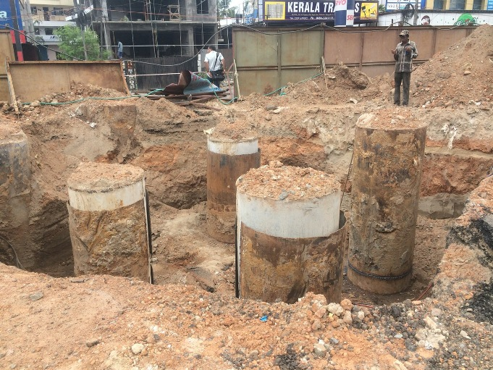
Flyover at Palarivattom in NH 66 (OLD 47) BYPASS
Progress Photos- 30.04.2015
Girder G19
AP1 Piercap concreting
Edappally West WMM spreading
P18 Pilecap excavation

Slide 12
ROB AT ALOOR – MALA

Slide 13
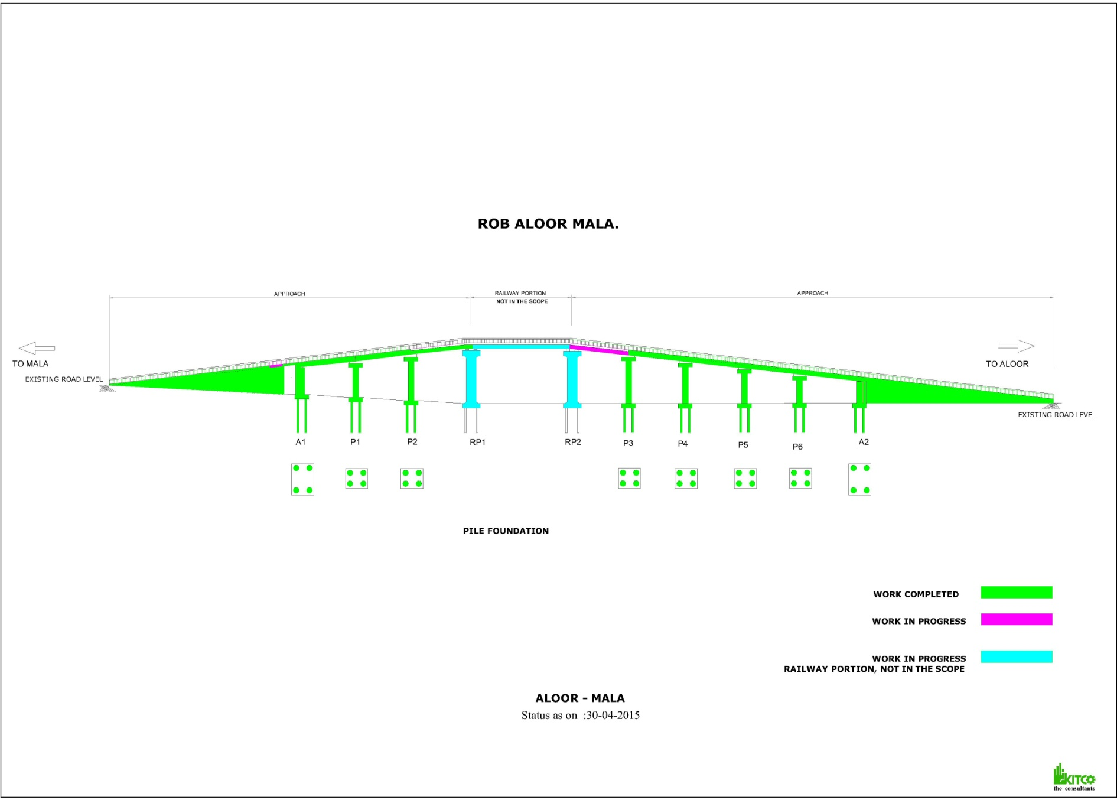
ROB AT ALOOR – MALA
PROGRESS GRAPH- 30.04.2015

Slide 14
ROB AT ALOOR – MALA
PROGRESS REPORT-30.04.2015
Sl No | Activity Description | Total Quantity | Cumulative progress upto April 2015 | Balance work up to April 2015 | Cumulative delay in days from Baseline | Work planned for April 2015 | Actual work done- April 2015 | Delay in Qty in April 2015 | Remarks
1 | Pile | 32 | 32 | 0
2 | Pile Load Test | 1 | 1 | 0
3 | Pilecap | 8 | 8 | 0
4 | Pier | 8 | 8 | 0
5 | Piercap | 6 | 6 | 0
6 | Girders | 8 | 8 | 0
7 | Deckslab | 8 | 8 | 0
8 | Handrails ,KERB & footpath slab casting | 8 | 8 | 0
9 | Retaining Wall MALA side | 100% | 100% | 0%
10 | Retaining Wall ALOOR side | 100% | 100% | 0%
11 | Diversion Road work MALA side | 100% | 100% | 0%
12 | Diversion Road work ALOOR side | 100% | 100% | 0%

Slide 15
ROB AT ALOOR – MALA
PROGRESS REPORT-30.04.2015
Sl No | Activity Description | Total Quantity | Cumulative progress upto April 2015 | Balance work up to April 2015 | Cumulative delay in days from Baseline | Work planned for April 2015 | Actual work done- April 2015 | Delay in Qty in April 2015 | Remarks
13 | Service Road- Aloor side | 100% | 50% | 50% |  | 50% | 20%
14 | Service road- Mala side | 100% | 100% | 0
15 | Earth filling inside approaches | 100% | 100% | 0% |  | 5% | 5%
16 | Load tst | 1 | 1 | 0
17 | Expansion joint | 100% | 100% | 0
18 | Under pass | 100% | 100% | 0
19 | Retaining wall kerb and handrail work aloor side . | 100% | 100% | 0
20 | Retaining wall kerb and handrail work Mala side . | 100% | 100% | 0 |  | 5% | 5%
21 | Adjacent span-Girder P3 - RP2 | 100% | 100% | 0% |  | 75% | 75%
22 | Adjacent span Girder P2 - RP1 | 100% | 100% | 0%
23 | Adjacent span slab P3-RP2 | 100% | 0% | 100% |  | 100% | 0% | 100%

Slide 16
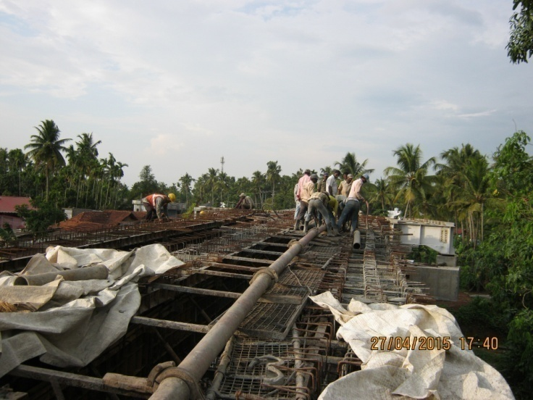
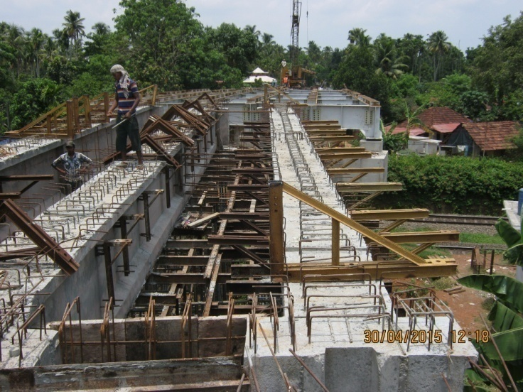
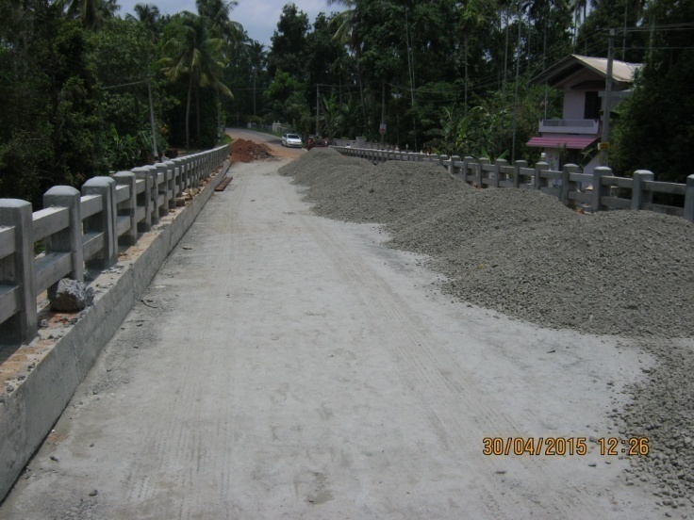
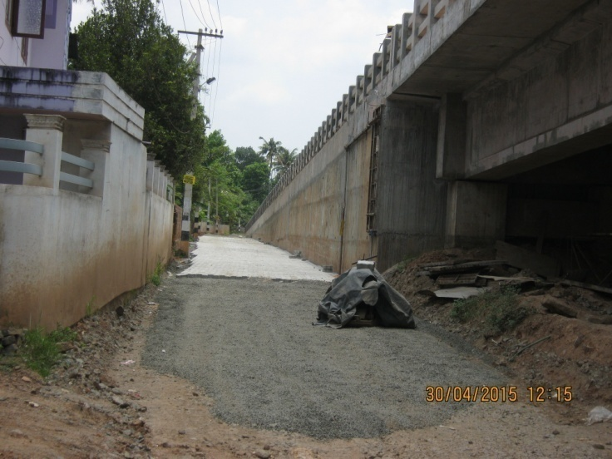
ROB AT ALOOR – MALA
PROGRESS PHOTOS- 30.04.2015
RP1-P2 Girder concreting
RP2-P3 Slab Work
Mala Side WMM work
Aloor side

Slide 17
ROB AT ANGADIPURAM

Slide 18
ROB AT ANGADIPURAM
PROGRESS GRAPH- 30.04.2015

Slide 19
ROB AT ANGADIPURAM
PROGRESS REPORT-30.04.2015
Sl No | Activity Description | Total Quantity | Cumulative progress up to April 2015 | Balance work up to April 2015 | Work planned for April 2015 | Actual work done during April 2015
1 | Pile | 56 | 56 | 0 | 0 | 0
2 | Pilecap | 18 | 13 | 5 | 0 | 0
3 | Pier | 18 | 11 | 7 | 2 | 0
4 | Piercap | 16 | 8 | 8 | 2 | 1
7 | Girders | 54 | 0 | 54 | 1 | 0
8 | Deckslab | 18 | 0 | 18 | 1 | 0

Slide 20
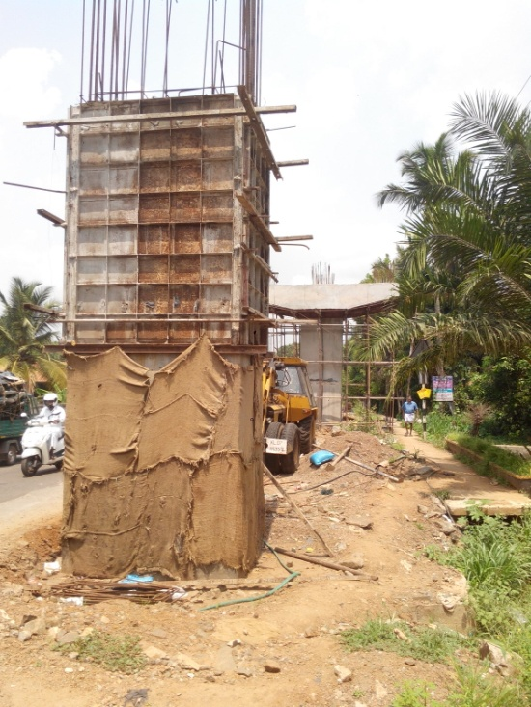
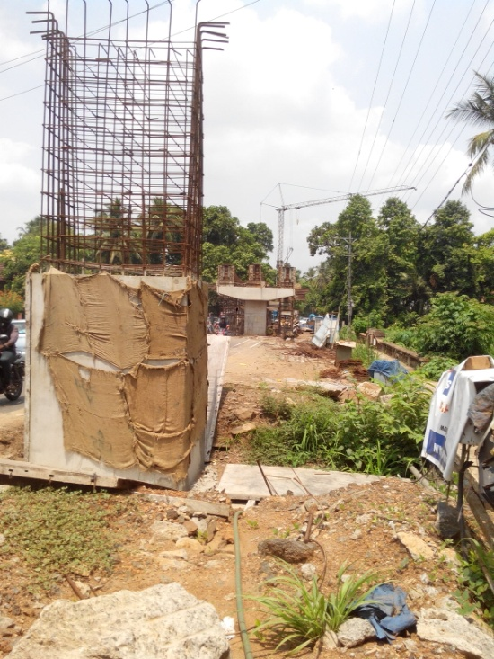
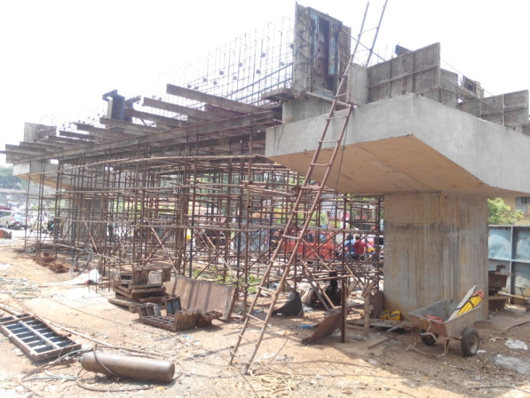
ROB AT ANGADIPURAM
PROGRESS PHOTOS – 30.04.2015
Girder P3-P4
Pier Cap P10 & P9
Pier Cap P6

Slide 21
Airport Seaport Road Phase II to Construction of Two River Bridges across Periyar-

Slide 22
Airport Seaport Road Phase II to Construction of Two River Bridges across Periyar- Progress Graph -30.04.2015

Slide 23
5.ONGOING PROJECT-PROGRESS REPORT
Airport Seaport Road Airport Seaport Road Phase II to Construction of Two River Bridges across Periyar- 30.04.2015
Airport Seaport Road Phase II to Construction of Two River Bridges
Airport Seaport Road Phase II to Construction of Two River Bridges across Periyar- Progress Report -30.04.2015
Sl No | Activity Description | Total Quantity | Cumulative progress upto April 15 | Balance work up to April 15 | Cumulative delay in days from Baseline | Work planned for April 15 | Actual work done-April 15 | Delay in Qty in April 15 | Remarks
1 | Pile | 73 | 69 | 4
2 | Pile Load Test | 3 | 2 | 1
3 | Pilecap | 18 | 17 | 1
4 | Pier | 18 | 17 | 1
5 | Piercap | 18 | 17 | 1
6 | Dirt wall | 4 | 2 | 2
6 | Girders ( Main Bridge) | 48 | 34 | 14 |  | 4 | 4
7 | Girders ( Main Bridge) launching | 48 | 31 | 17 |  | 7 | 6
7 | Deckslab | 12 | 4 | 8 |  | 1 | 1
8 | Handrails & footpath slab casting | 100% | 0% | 100%
9 | Retaining Wall Aluva side | 100% | 0% | 100%
10 | Retaining Wall Thuruthu side | 100% | 0% | 100%
11 | Road work Aluva side | 100% | 0% | 100%
12 | Road work Thuruthu side | 100% | 60% | 40%
13 | Girders ( Minor bridge) | 16 | 7 | 9 |  | 2 | 0

Slide 24
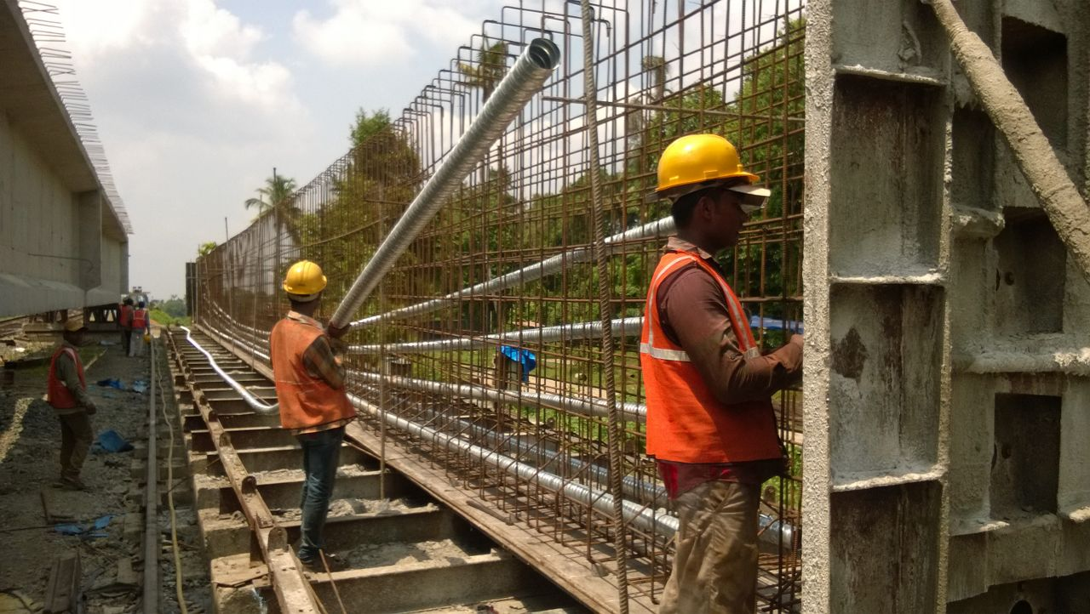
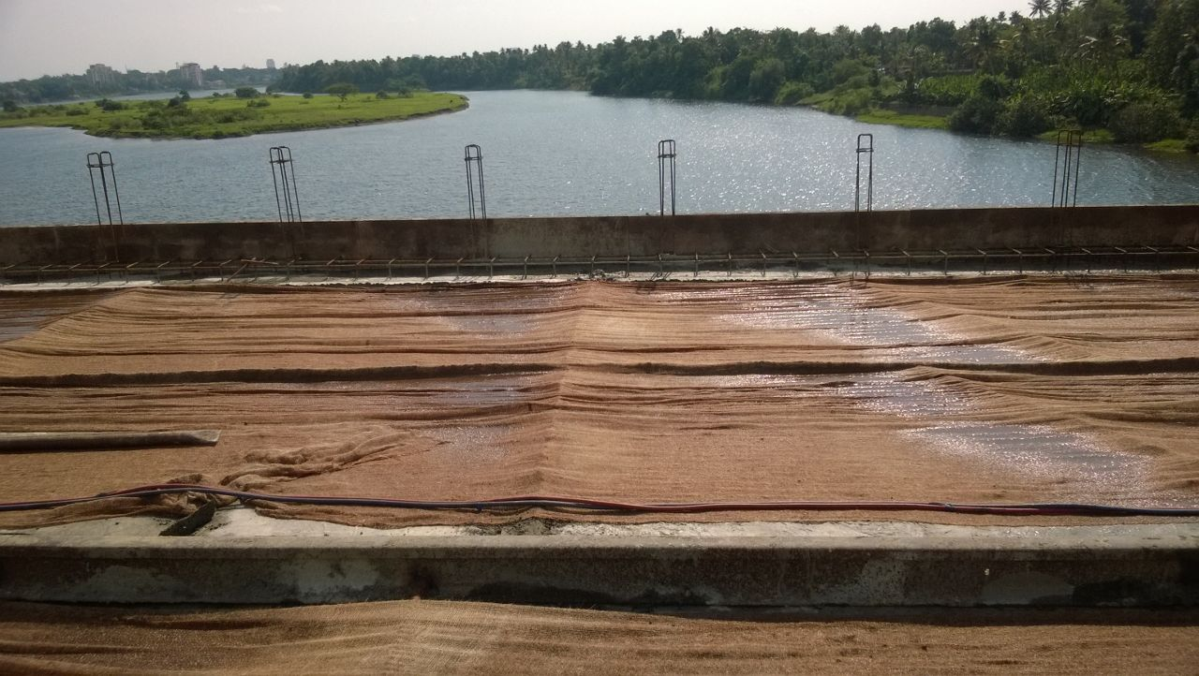
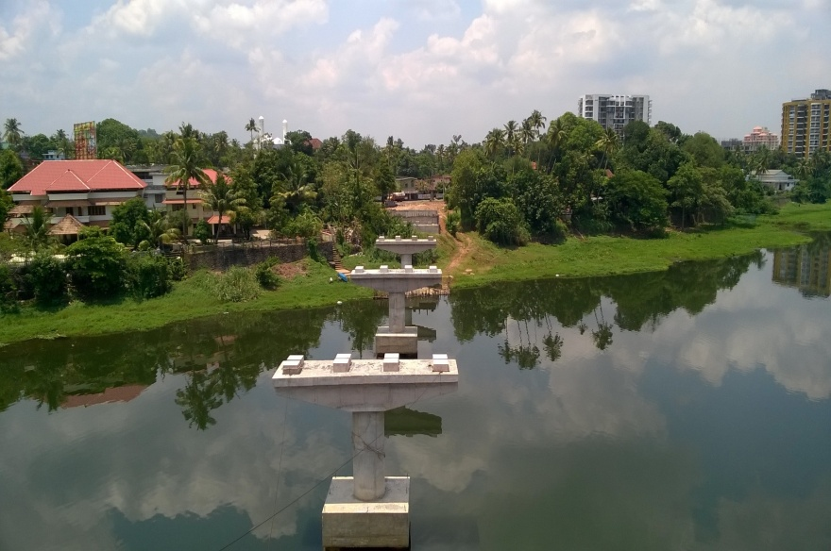
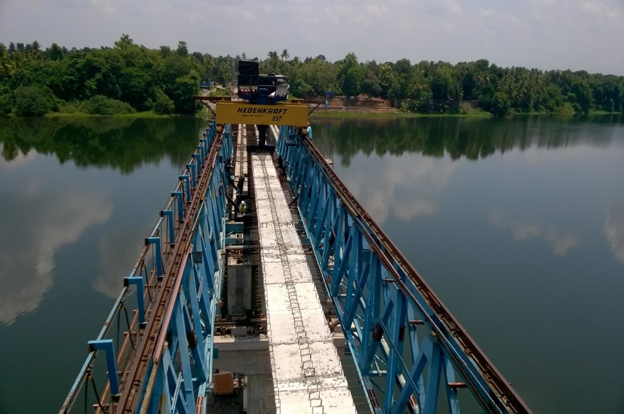
Airport Seaport Road Phase II to Construction of Two River Bridges across Periyar- Progress Photos-30.04.2015
Cable Profiling 34th Girder (Main Bridge)
Curing 4th deck slab(Main Bridge)
View from Thuruth side (Main Bridge)
Launching of 30th Girder (Main Bridge)

Slide 25
ROB AT KUMARANELLUR

Slide 26
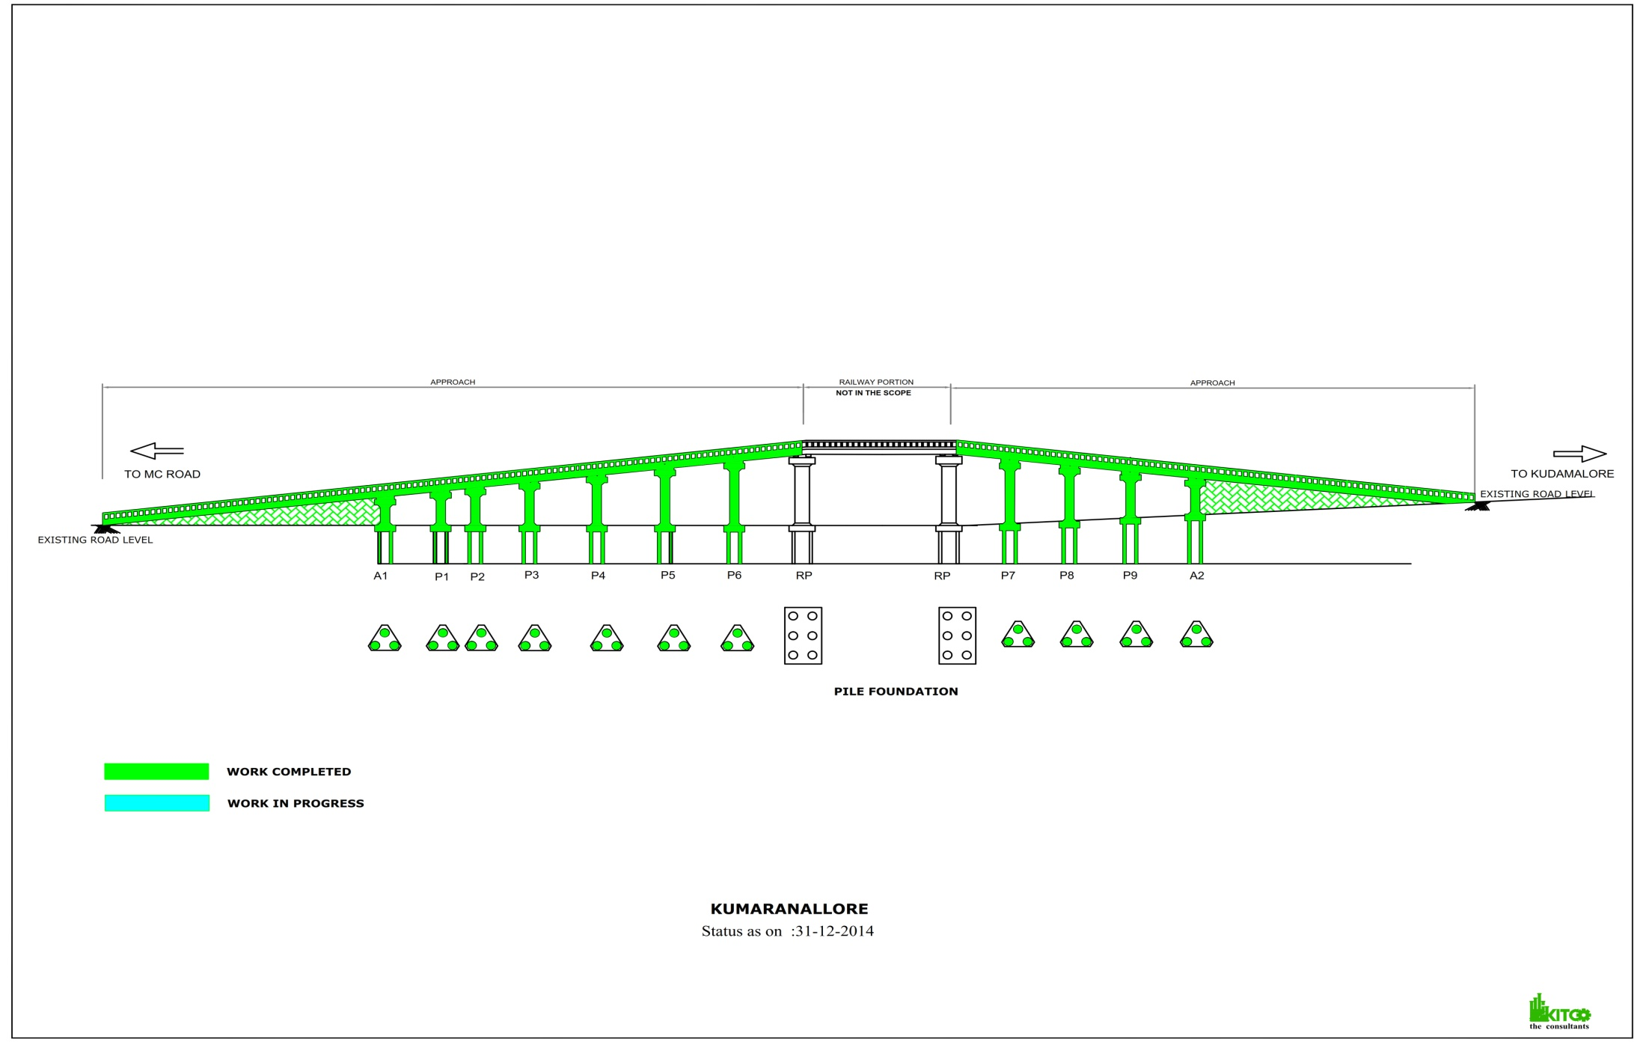
ROB AT KUMARANELLUR
PROGRESS GRAPH – 30.04.2015

Slide 27
ROB AT KUMARANELLUR
PROGRESS REPORT-30.04.2015
Sl No | Activity Description | Total Quantity | Cumulative progress up to April 2015 | Balance work up to April 2015 | Cumulative delay in days from Baseline | Work planned for April 2015 | Actual work done- April 2015 | Delay in Qty in April 2015 | Work Planned for next Month | Remarks
1 | Pile | 33 | 33 | 0
2 | Pile Load Test | 1 | 1 | 0
3 | Pilecap | 11 | 11 | 0
4 | Pier | 11 | 11 | 0
5 | Piercap | 11 | 11 | 0
6 | Girders | 11 | 10 | 1
7 | Deckslab | 11 | 10 | 1
8 | Handrails casting | 00% | 80% | 20%
9 | Retaining Wall Kudamaloor side | 100% | 100% | 0%
10 | Retaining Wall MC Road side | 100% | 100% | 0%
11 | Road work Kumaranellur side | 100% | 100% | 0% |  | 25% | 25% | 0%
12 | Road work MC ROAD side | 100% | 100% | 0% |  | 25% | 25% | 0%

Slide 28
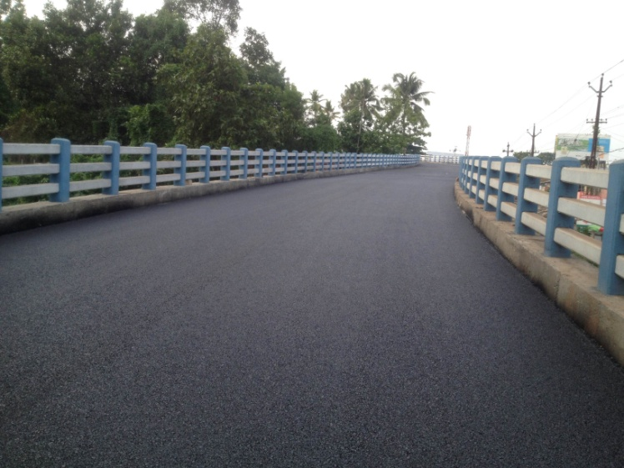
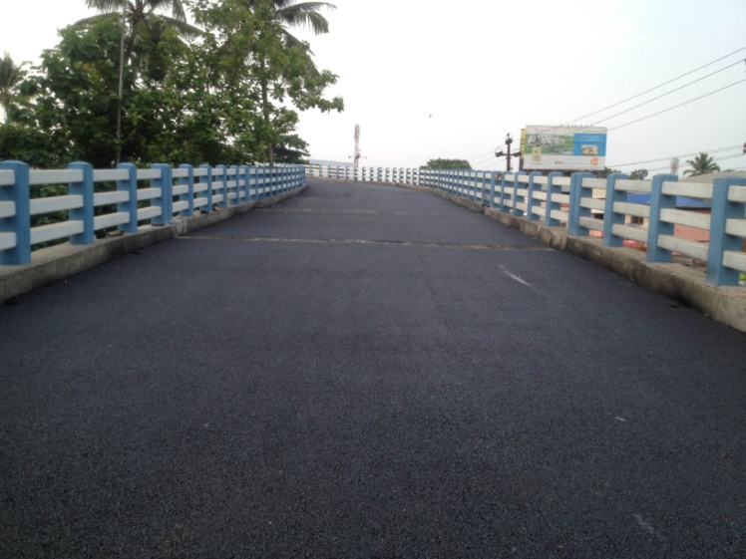
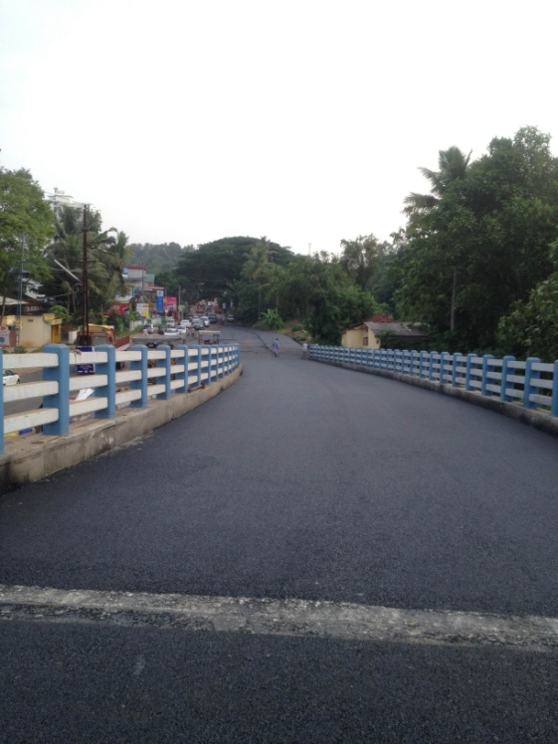
ROB AT KUMARANELLUR
PROGRESS PHOTOS- 30.04.2015
Black topping completed

Slide 29
ROB AT KUNHIPALLI-

Slide 30
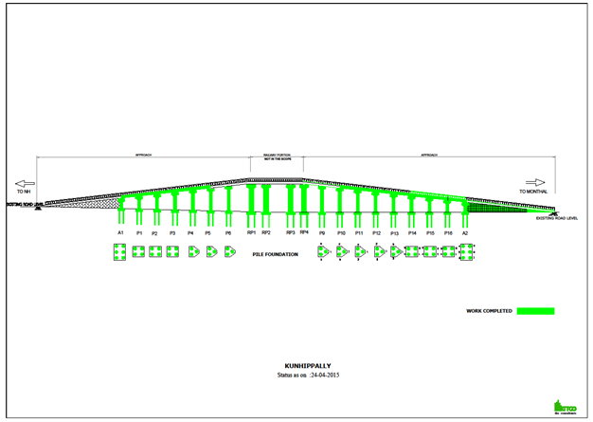
ROB AT KUNHIPALLI-
PROGRESS GRAPH 30.04.2015

Slide 31
7.ONGOING PROJECT-PROGRESS REPORT
ROB AT KUNHIPALLI- 30.04.2015
ROB AT KUNHIPALLI-
PROGRESS REPORT - 30.04.2015
Sl No | Activity Description | Total Quantity | Cumulative progress upto April 15 | Balance work up to April 15 | Cumulative delay in days from Baseline | Work planned for April 15 | Actual work done-April 15 | Delay in Qty in April 15 |  | Remarks
1 | Pile | 60 | 60 | 0
2 | Pile Load Test | 1 | 1 | 0
3 | Pilecap | 16 | 16 | 0
4 | Pier | 16 | 16 | .0
5 | Piercap | 16 | 16 | 0
6 | Girders | 16 | 12 | 4
7 | Deckslab | 16 | 12 | 4
8 | Handrails & footpath slab casting | 100% | 25% | 75%
9 | Retaining Wall NH side | 100% | 10% | 90%
10 | Retaining Wall Mondhal Bridge side | 100% | 50% | 50%
11 | Road work NH side | 100% | 0% | 100%
12 | Road work Mondhal Bridge side | 100% | 0% | 100%
13 | Drain Mondhal Bridge side | 100% | 100% | 0% |  | 15% | 15% | 0
14 | Service road Mondhal Bridge side | 100% | 75% | 25%
15 | Culvert Mondhal Bridge side | 100% | 100% | 0%

Slide 32
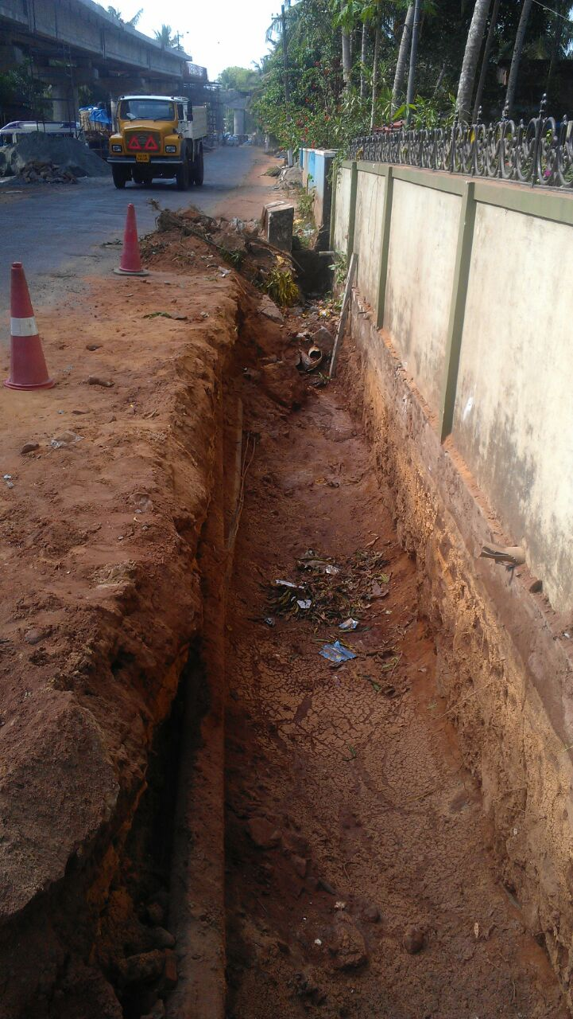
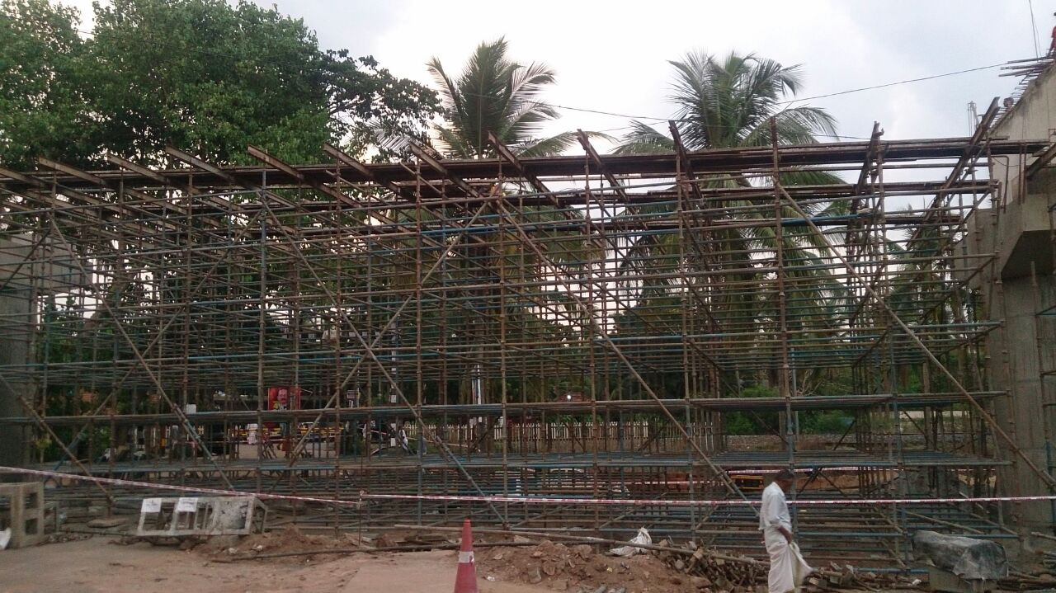
ROB AT KUNHIPALLI-
PROGRESS PHOTOS - 30.04.2015
P5-P6 Girder Bottom shutter fixing
Excavation for drain in Monthal side

Slide 33
ROB AT EROOR

Slide 34
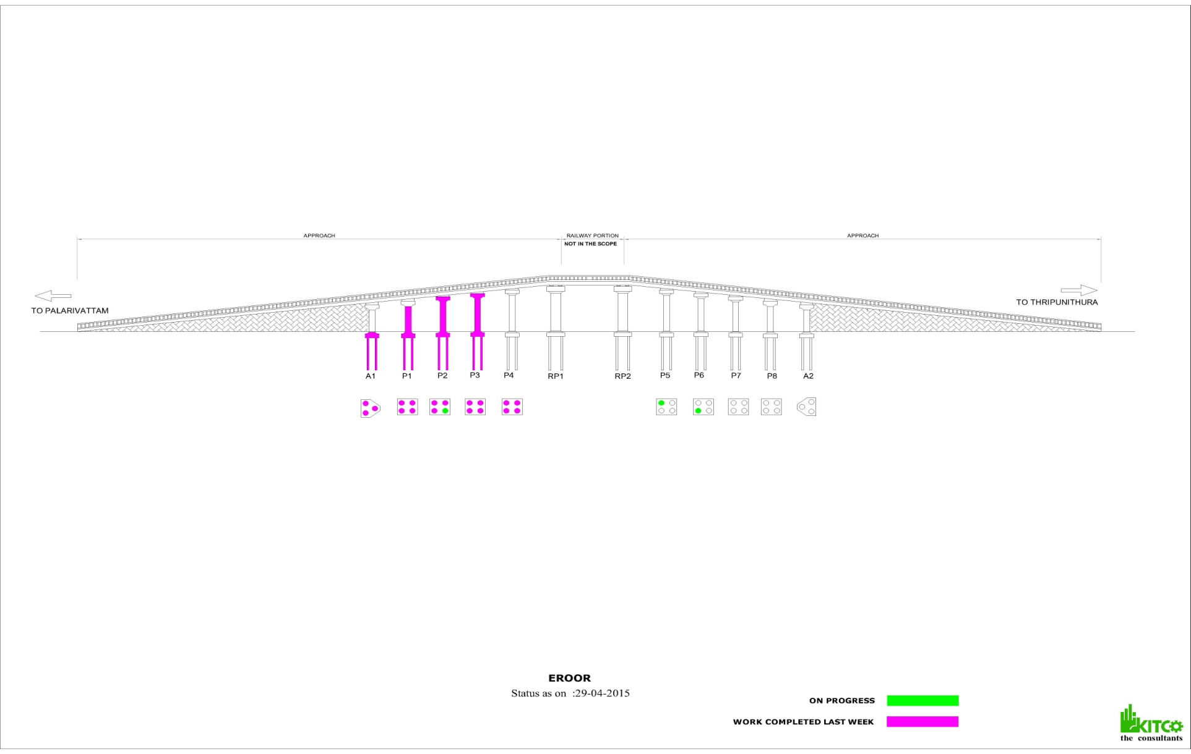
ROB AT EROOR
PROGRESS GRAPH- 30.04.2015

Slide 35
ROB AT EROOR
PROGRESS REPORT-30.04.2015
Sl No | Activity Description | Total Quantity | Cumulative progress up to April 2015 | Balance work up to April 2015 | Work planned for April 2015 | Actual work done during April 2015
1 | Pile | 38 | 19 | 19 | 2 | 0
2 | Pilecap | 10 | 4 | 6 | 2 | 1
3 | Pier | 10 | 3 | 7 | 2 | 1
4 | Piercap | 10 | 2 | 8 | 2 | 2
7 | Girders (8+2) | 10 | 0 | 10 | 0 | 0
8 | Deckslab (8+2) | 10 | 0 | 10 | 0 | 0
9 | Drainage |  | 10m |  | 200m | 10m

Slide 36
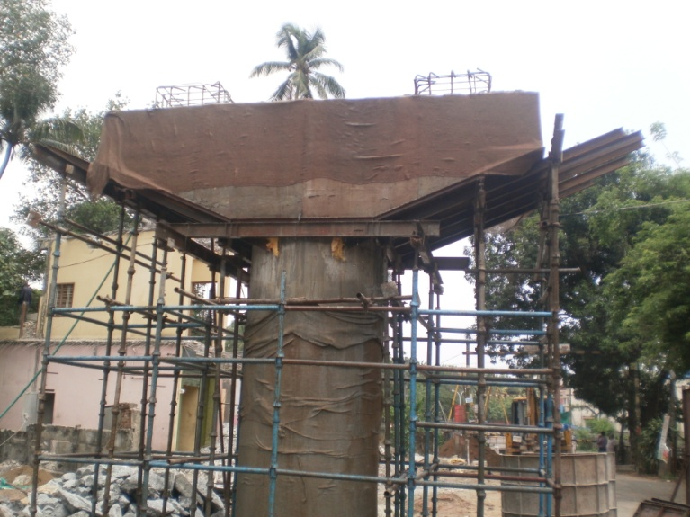
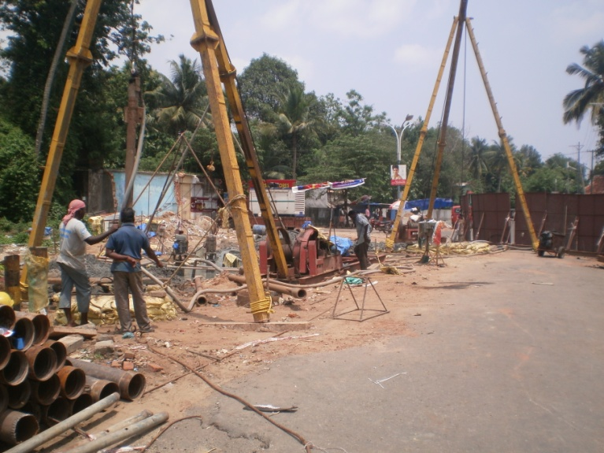
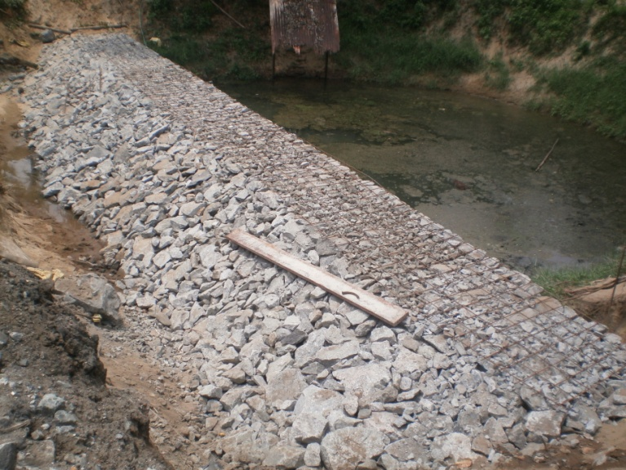
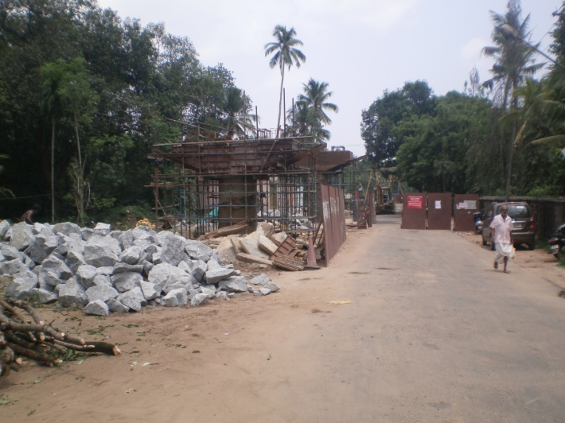
ROB AT EROOR
PROGRESS PHOTOS – 30.04.2015
P3 Pier cap
Boring in P 5 & P6 location
Rubble work for pond
P2 Pier cap

